Slide 1
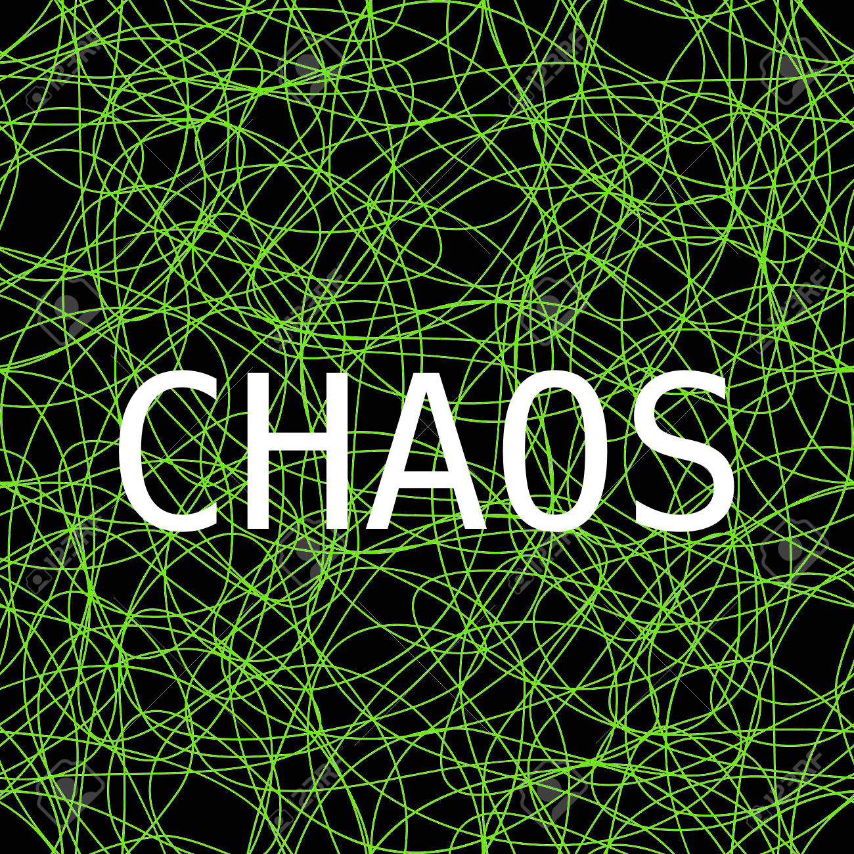
SCATTERING
And Skateboarders

Slide 2
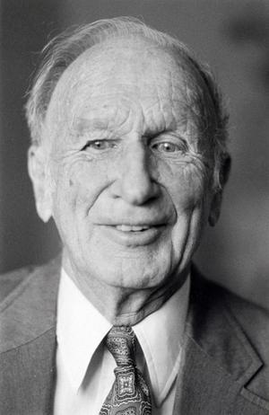
Chaos Theory
Edward Norton Lorenz
Notes:
Before

Slide 3
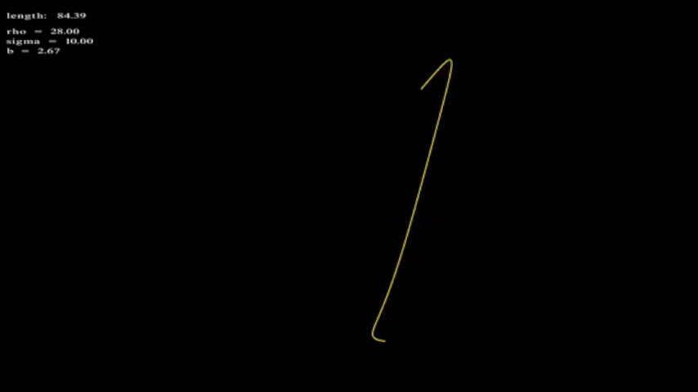
Chaos Theory
A Plot of the Lorenz System
Notes:
He created a model for convection currents in the air, and using those he created a simulation. The screen has a new version of the same simulation playing right now.

Slide 4
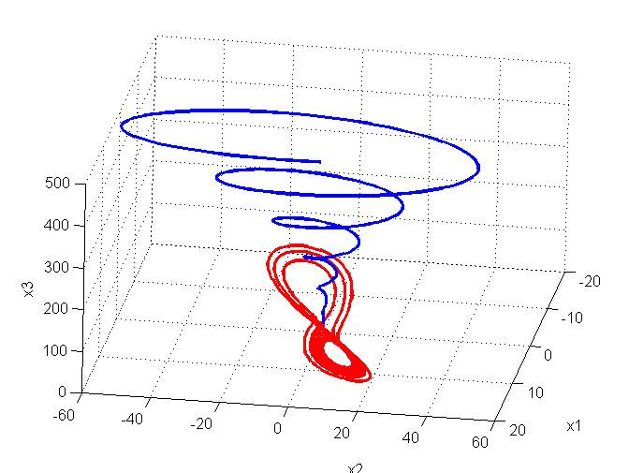
Chaos Theory
The Lorenz System for two sets of initial values
Notes:
He created a model for convection currents in the air, and using those he created a simulation. The screen has a new version of the same simulation playing right now.

Slide 5
Chaos Theory
Small changes in inputs can cause drastic changes in outputs
"Predictability: Does the Flap of a Butterfly's Wings in Brazil Set Off a Tornado in Texas?"
Edward Norton Lorenz

Slide 6
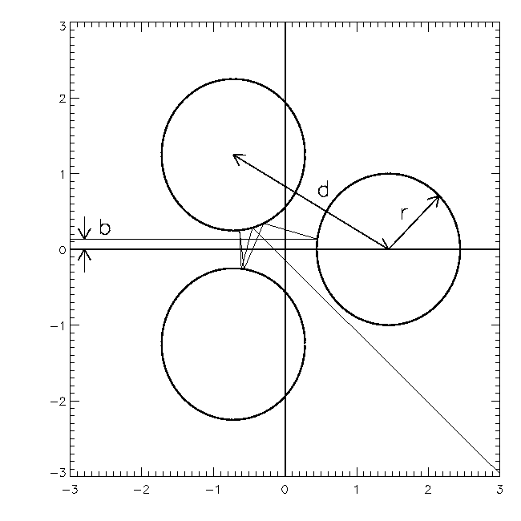
What is Chaotic Scattering?
USES OF STUDY
Understand celestial mechanics
Scattering in nuclear physics
Insights to how fractals form in nature
The Gaspard-Rice Scattering System

Slide 7
Ordinary Differential Equations
A differential equation containing one or more functions of one independent variable and its derivatives.
Integrating the acceleration with respect to time gives us the position of the mass at a chosen time.

Slide 8
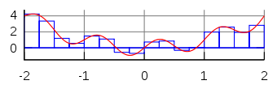
Numerical Integration Techniques
Simpsons Method
Euler – Cromer
Runge – Kutta

Slide 9
SOFTWARE

Slide 10
Results

Slide 11
Results
Chaotic Versus Non Chaotic Nature
Fractal Nature
Energy Conservation
Affects of Velocity on Scattering Angle

Slide 12
Results: Chaotic & Non Chaotic Nature

Slide 13
Results: Fractal Nature
-5 < b < 5

Slide 14
Results: Fractal Nature
-5 < b < 5

Slide 15
Results: Fractal Nature
-3 < b < 3

Slide 16
Results: Fractal Nature
-3 < b < 3

Slide 17
Results: Fractal Nature
-1 < b < 0

Slide 18
Results: Fractal Nature
-1 < b < 0

Slide 19
Results: Fractal Nature
-0.8 < b < -0.65

Slide 20
Results: Fractal Nature
-0.8 < b < -0.65

Slide 21
Results: Fractal Nature
Fractal appears to end here because I was incrementing b by 0.005
-0.76 < b < -0.74

Slide 22
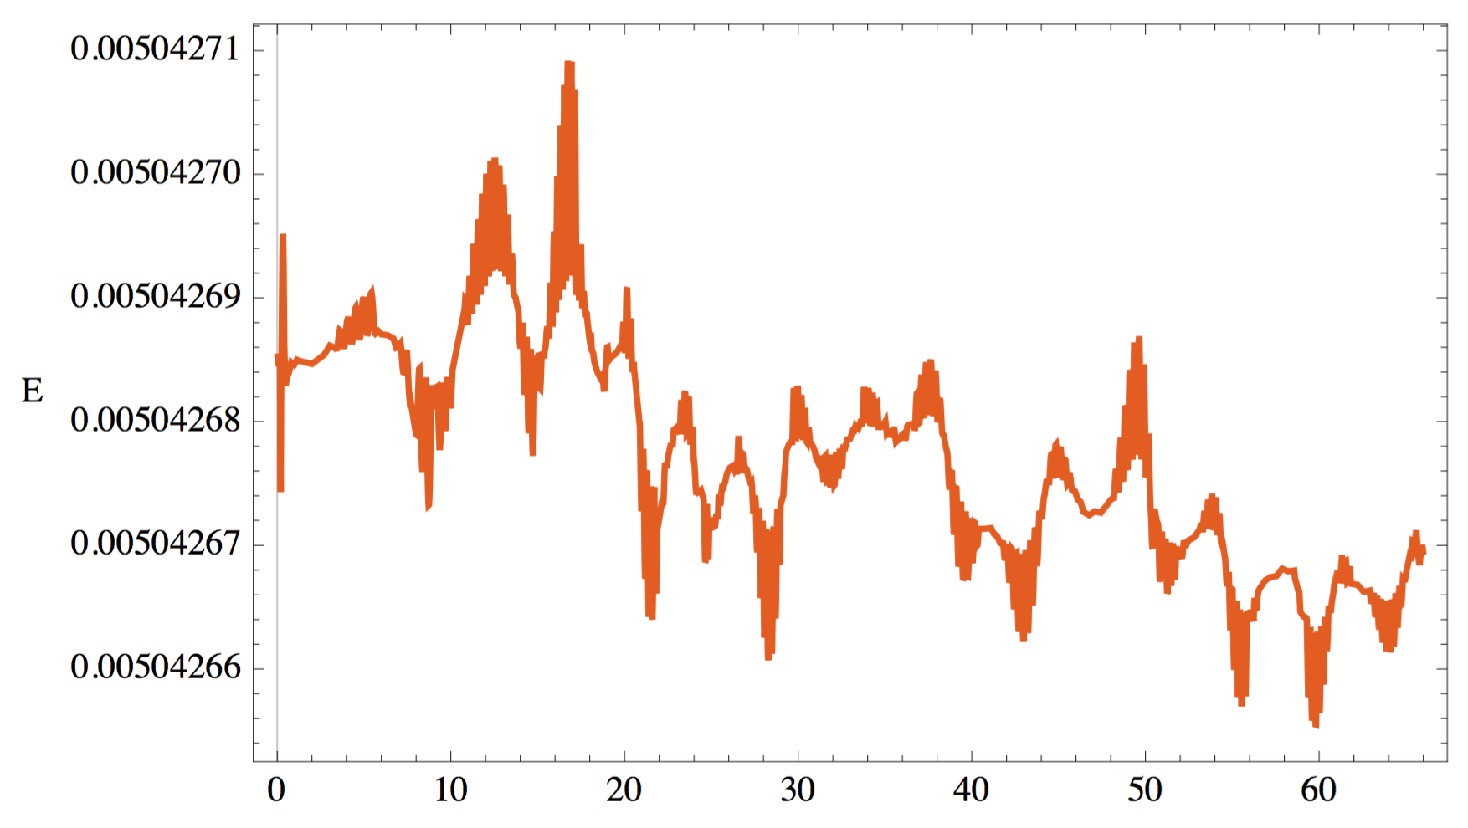
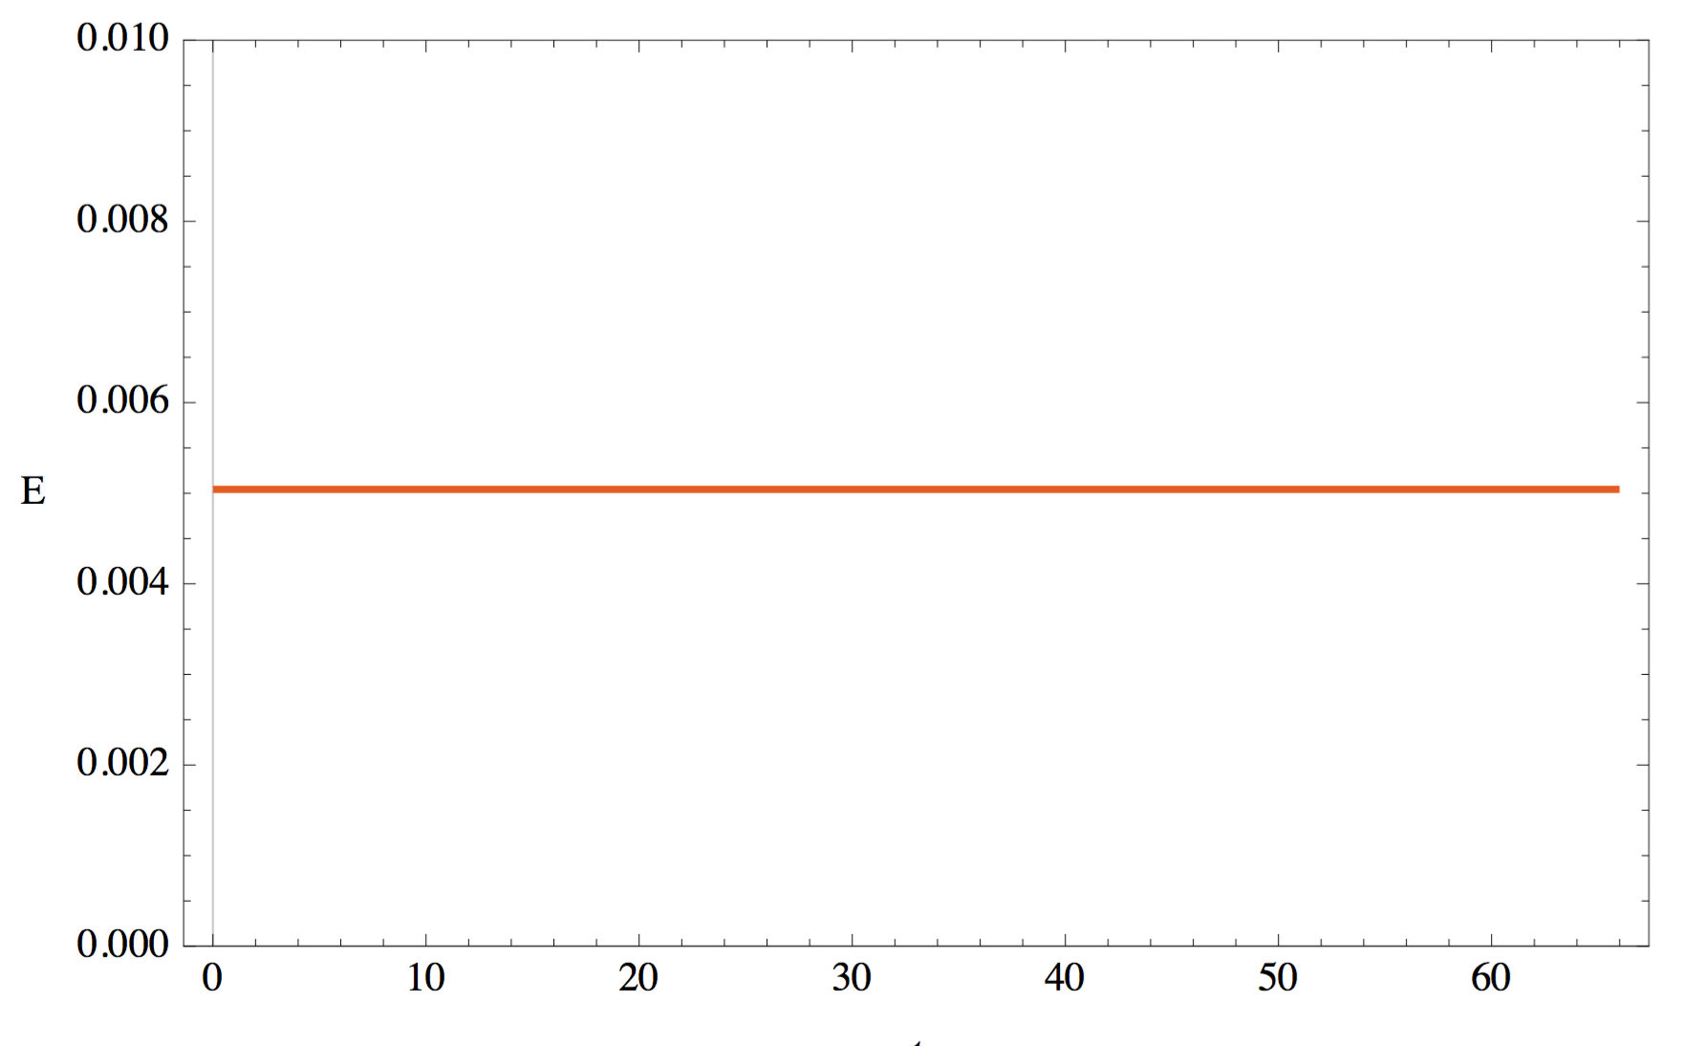
Results: Energy Conservation

Slide 23
Results: Energy Conservation

Slide 24
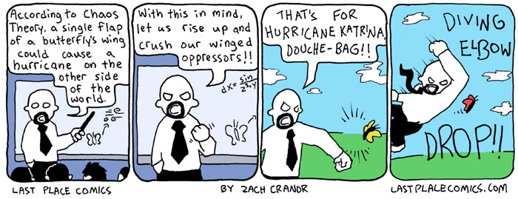
Concluding Notes
you jerk!

